Slide 1







Slide 2
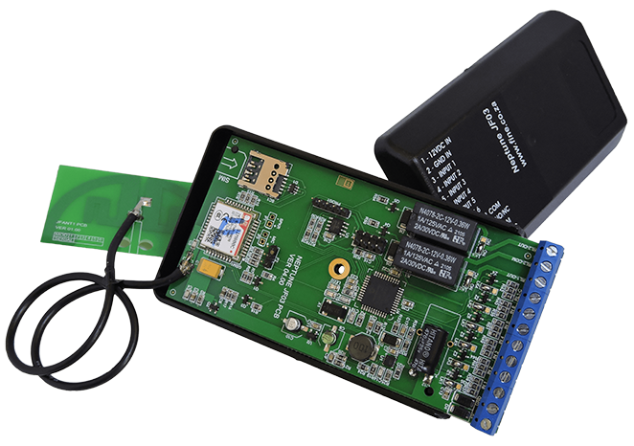
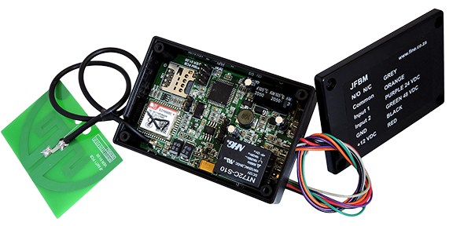
Mercury Battery Monitor / Gate Access Controller
Neptune 6 Input 2 Output Controller

Slide 3
Mercury Battery Monitor / Gate Access Controller
Neptune 6 Input 2 Output Controller

Slide 4
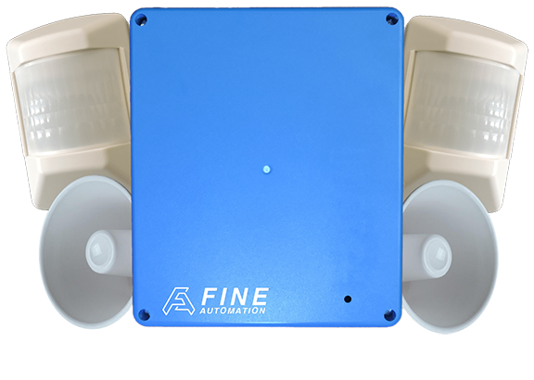
Venus Wireless Alarm System

Slide 5
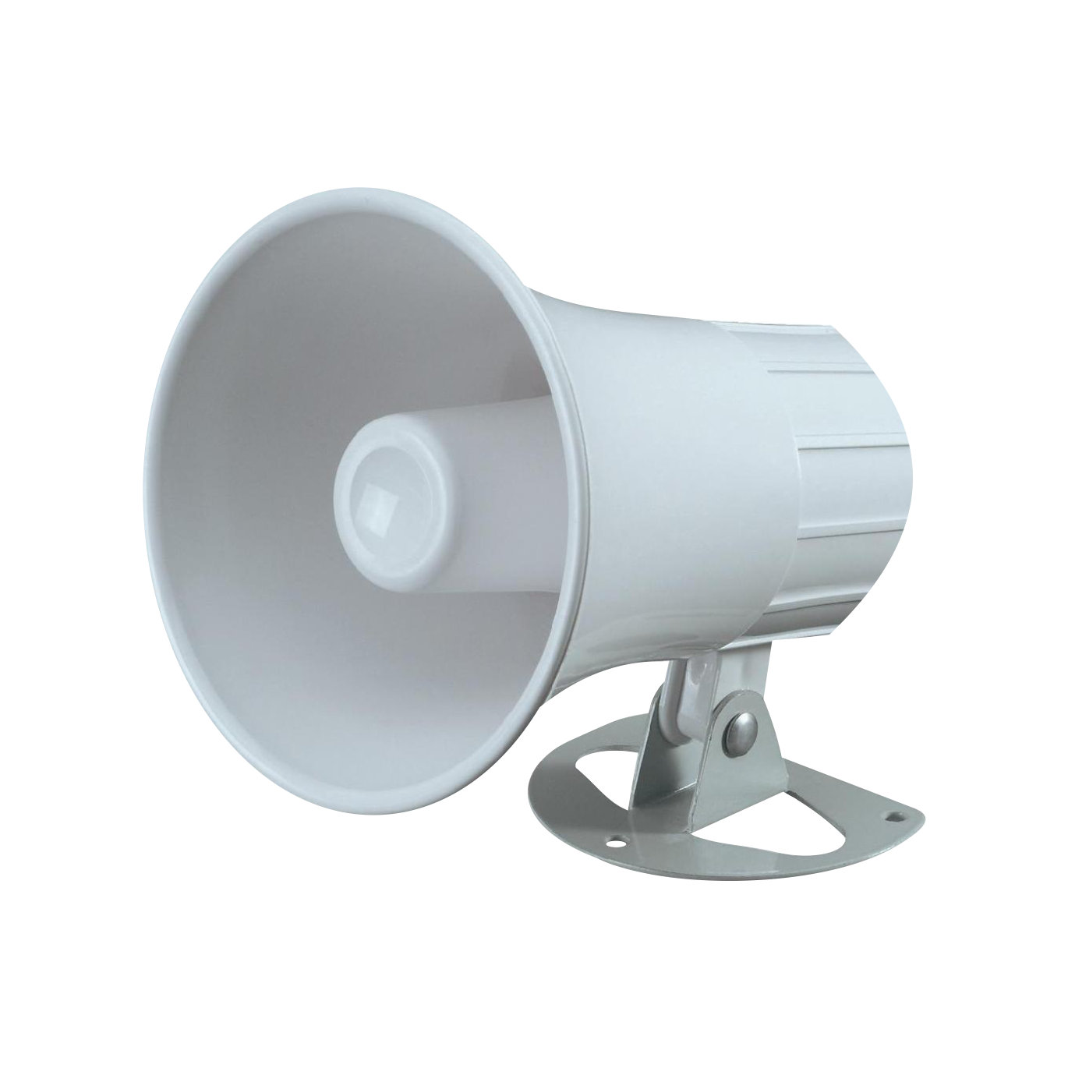
15 Watt Wired Siren Alarm

Slide 6
Venus Wireless Alarm System

Slide 7
15 Watt Siren Alarm

Slide 8
Mercury Battery Monitor / Gate Access Controller
Neptune 6 Input 2 Output Controller
Used for battery monitoring or gate access control. Can store up to 400 drop-call numbers and can SMS up to 7 numbers. The 2 inputs can measure and send SMSes for any voltage levels from 0V-70V. Comes with a 10A relay output. The unit is powered by either a 12V power supply or battery.
Used for pump and water/dam level control, temperature control and other monitoring systems. Can SMS up to 7 numbers. The 6 inputs can measure from 0V to 12V. The unit is powered by either a 12V power supply or battery.
Find Our More
Find Our More

Slide 9
Mercury Battery Monitor / Gate Access Controller
Venus Wireless Alarm System
Used for battery monitoring or gate access control. Can store up to 400 drop-call numbers and can SMS up to 7 numbers. The 2 inputs can measure and send SMSes for any voltage levels from 0V-70V. Comes with a 10A relay output. The unit is powered by either a 12V power supply or battery.
Has 6 zones, each can have 2 passives allowing for 12 wireless passives or door guards to be connected. Controlled with remote or by sending SMSes. Powered by a 12V power supply with 10 hour battery reserve. Connections for buzzer, siren and radio transmitter. Can SMSes up to 6 numbers and GPRS number.
Find Our More
Find Our More

Slide 10
Venus Wireless Alarm System

